Slide 1
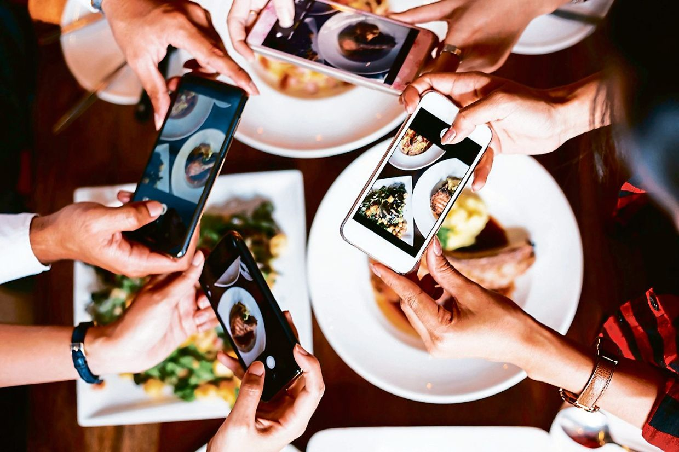
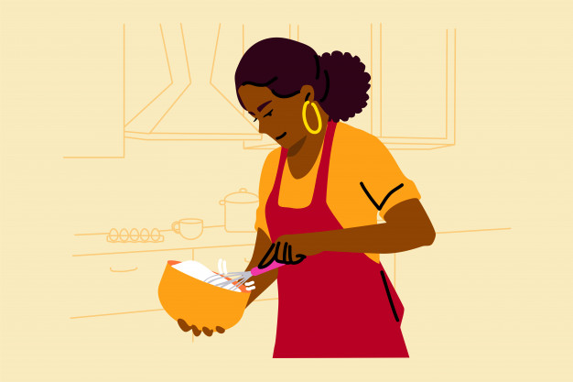
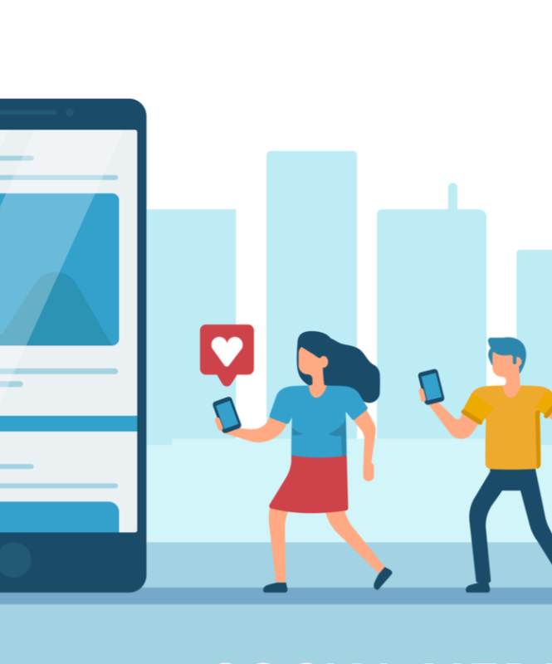
AKYC SOCIAL MEDIA PROJECT
Ali Haydar Konuk | Yaren Çoşkun

Slide 2
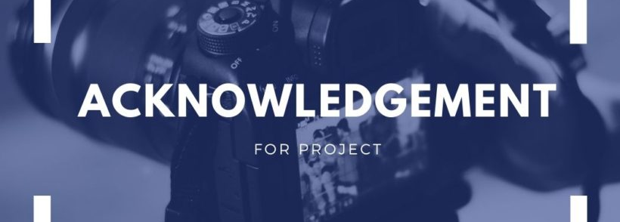
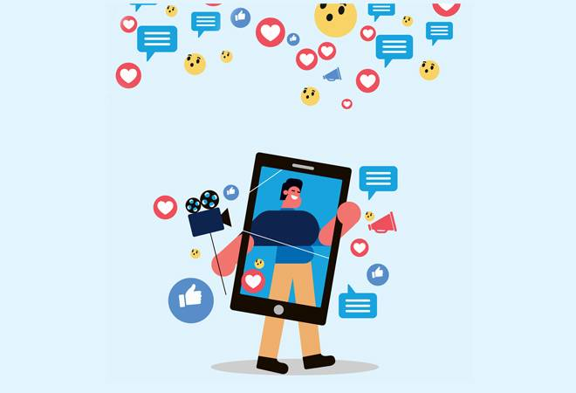
In the beginning
We would like to thank our supervisor teacher Asst. Prof. Günet Eroğlu , who helped us with her guidance and comments throughout the project.

Slide 3
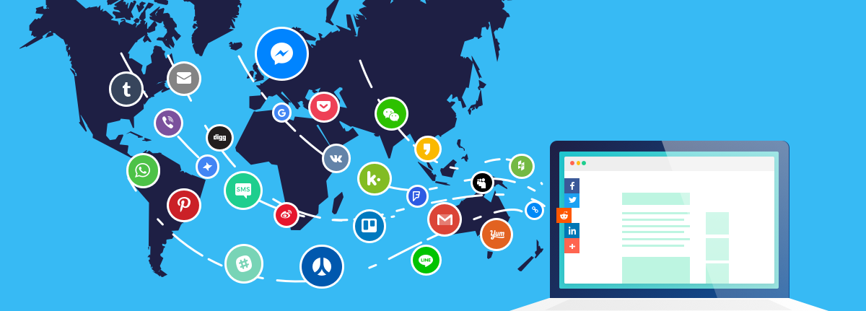
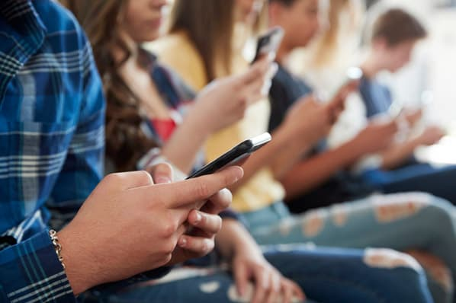
What is Social Media?
Applications that allow users to establish an interactive relationship through a common platform are called social media.

Slide 4


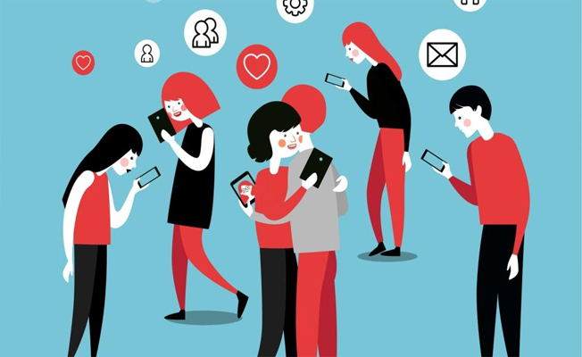
Shortcomings of Social Media Applications
Social media applications define themselves only as a common network.
This creates a disadvantage in terms of following the special interests.
It makes difficult for users to stay up to date in these areas.

Slide 5

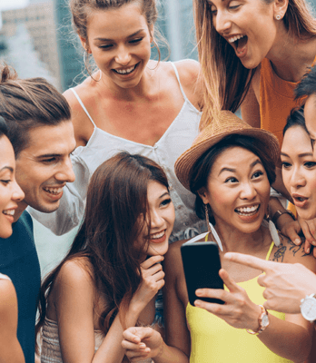
As a Solution
Certain interest areas should have their own specific common networks. If such social media applications increase, it becomes easier for those who are interested to share ideas, and a platform that can be formed where anyone can be consult to other users in terms of this special topic.

Slide 6

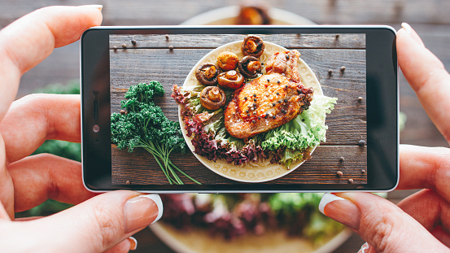
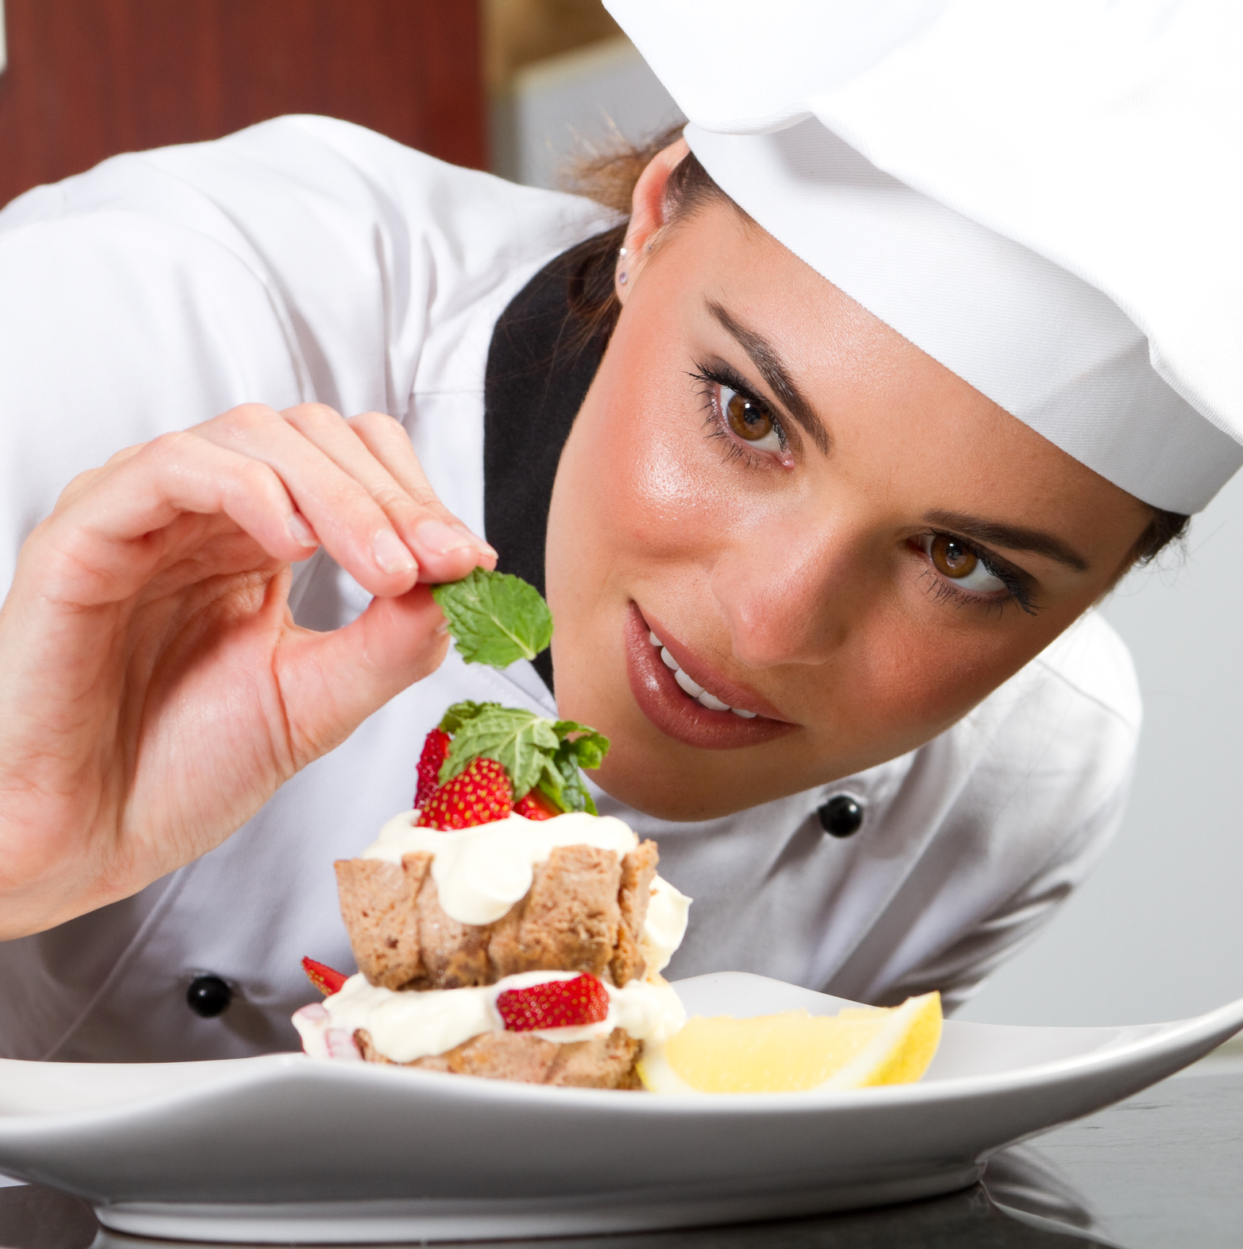
Why Gastronomy?
There are only websites based on providing information.
There is no other example of social media website for gastronomy.
Culinary arts are more popular today

Slide 7




Technologies we use
MongoDB as database.
ExpressJS that web application framework based on NodeJS.
Handlebars template engine for frontend.
JavaScript as a programming language.

Slide 8
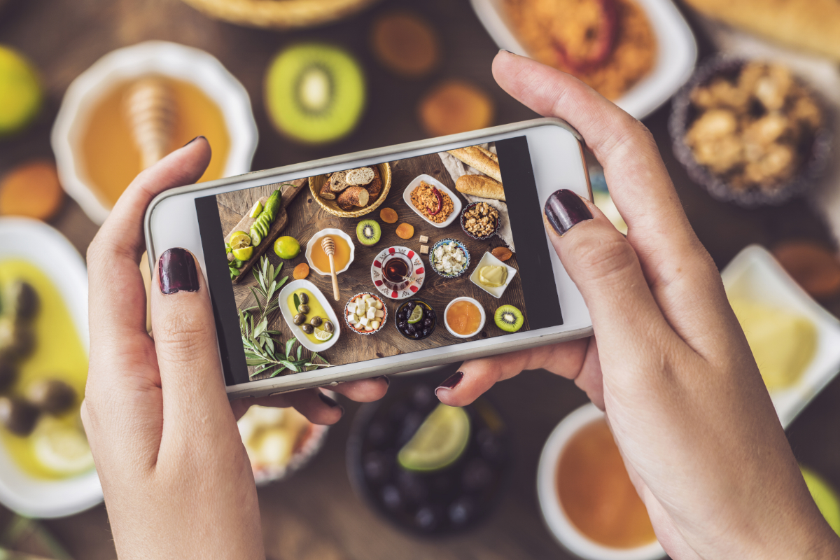
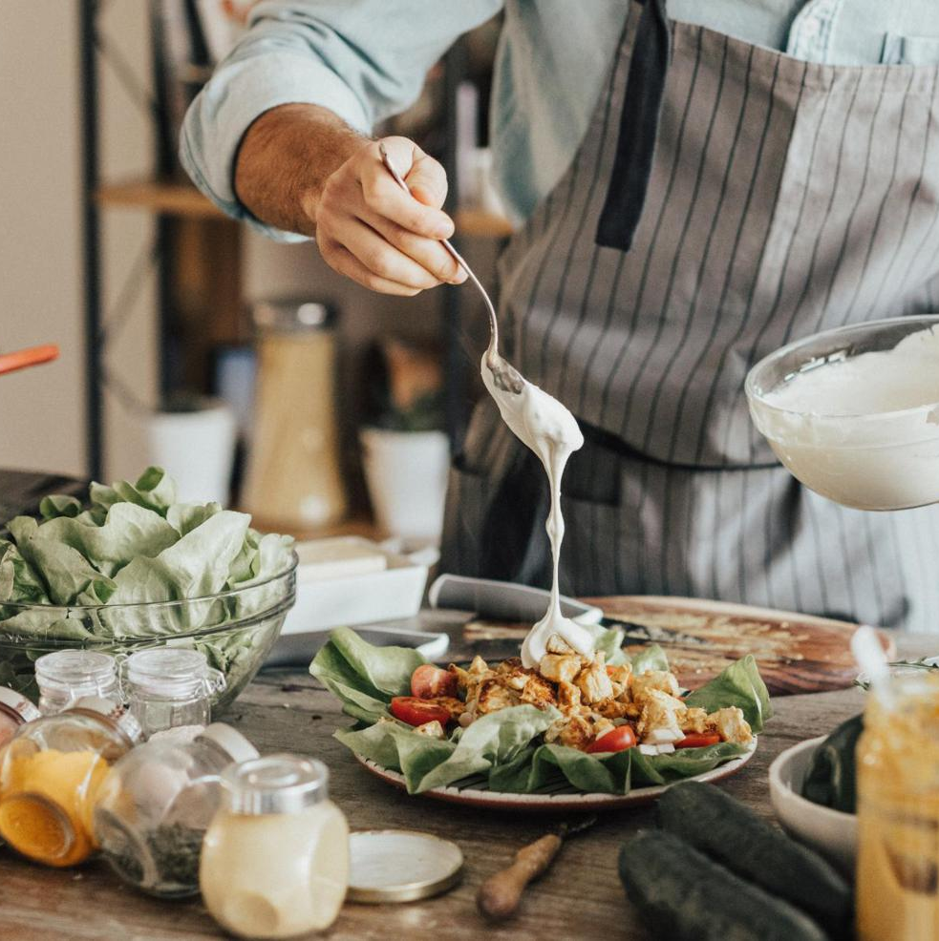
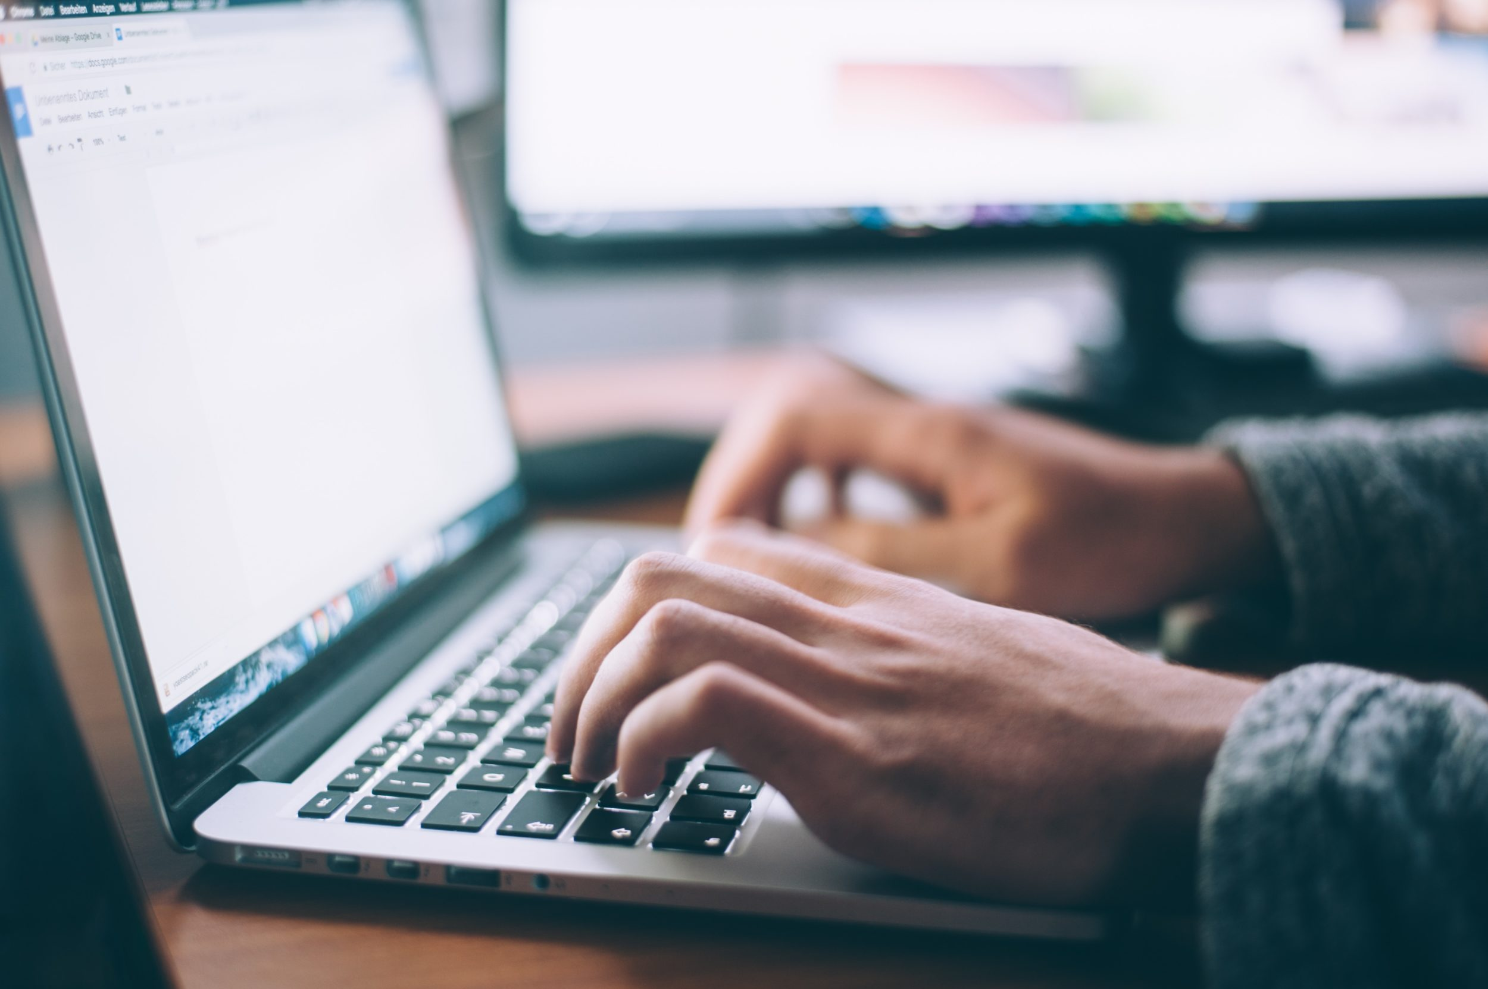
About The Project
Everyone can register.
Users can share post, leave a comment and like any post.
Users can update their personal information.
Users can search and follow other users.
Users can send a request for verification.
Admin can delete posts and comments.
Admin can accept/decline verification requests.

Slide 9
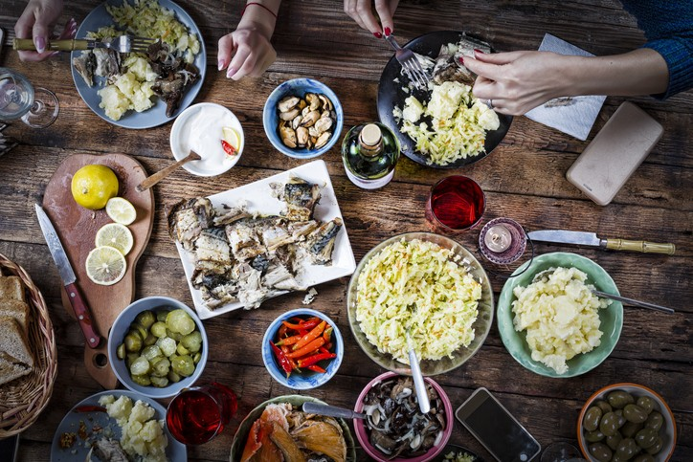
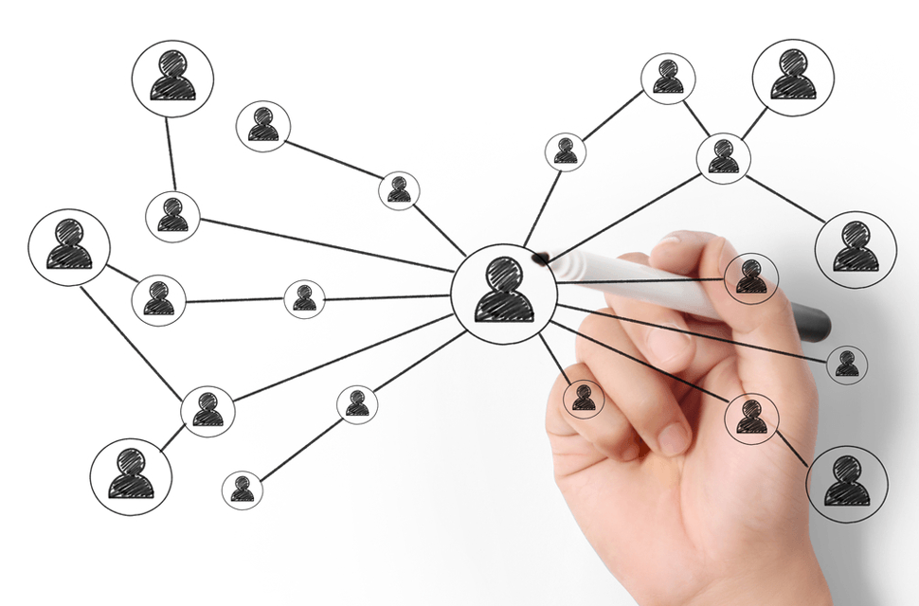
Thank You For Your Attention

